Slide 1
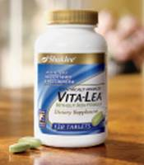
Presenter: Rick Seymour
Jack and Pat Seitzinger

Slide 2
REAL DIRT ON CLEAN
81,000 CHEMICALS REGISTERED WITH THE EPA IN THE LAST 30 YEARS,
and fewer than 20% have been tested for toxicity!
FACT: 90% of all poison exposures occur at home
FACT: 218,316 reported poison exposures in 2005 were from household cleaning products
FACT: Most common poisoning among children: Dishwasher detergents!
FACT: Indoor pollutants come from all sorts of chemicals we use to make our lives easier every day
FACT: EPA studies indicate that elevated concentration of household chemicals persist in the air. Long-term exposure to chemicals inside our homes may be harmful to us and our families
Notes:
Why we wanted to get out of corporate
Did not like all the people we worked with. Many I would not hire.
Shaklee Basic H first to be names as an earth day product
Shaklee cleans better than all products
Made from corn and soy- will not test on animals
What are we brining into our homes?
Toxic poisoning in our homes not so much in industry- they cleaned up their act.
Women who work at home have a 42% higher incident of cancer- more than those that work

Slide 3
REAL DIRT ON CLEAN
FACT: Some 20 million Americans have asthma
FACT: An average of one out of every 13 school-aged children has asthma
FACT: Asthma rates in children under age five have increased more than 400% in the last 15 years
FACT: Common household cleaners and appliances give off fumes, which can potentially increase the risk of children developing asthma
“We are conducting a vast toxicologic experiment in our society, in which our children and our children’s children are the experimental subject” Dr. Herbert Needleman Pediatrician and Professor at the University of Pittsburgh Medical Center

Slide 4
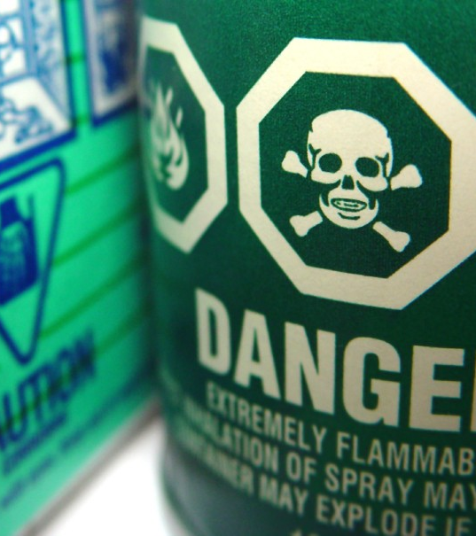
ARE YOU LIVING IN A TOXIC HOME?
FACT: The average U.S. household generates more than 20 pounds of hazardous waste each year
FACT: Most household cleaning products are designated as hazardous waste by the EPA, and “improper disposal of these wastes can pollute the environment and pose a threat to human health”
FACT: Women who work at home have a 42% higher incidence of all types of cancer than women who work outside the home.
Oven cleaners
Drain cleaners
Wood and metal cleaners and polishes
Toilet cleaners
Tub, tile, and shower cleaners
Bleach (laundry)
Notes:
Plastic is biggest polluter
1,000 miles off California there is a dump of all the plastic materials dumped into the ocean. This is killing sea life. Every square mile of ocean has 41,000 plastic diswcards

Slide 5
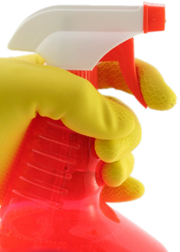
WHAT’S UNDER YOUR SINK?
Chlorine Bleach is the chemical most frequently involved in household poisonings in the U.S.
Degreasers may contain petroleum distillates, which can damage lung tissues and dissolve fatty tissue around nerve cells
Glass Cleaners may contain ammonia. Ammonia fumes can irritate the skin, eyes and respiratory system
Oven Cleaners can be one of the most dangerous cleaning products, which can cause severe damage to eyes, skin, mouth, and throat
Toilet Bowl Cleaners can be extremely dangerous cleaning products, which can be harmful just by breathing the fumes—and fatal if swallowed

Slide 6
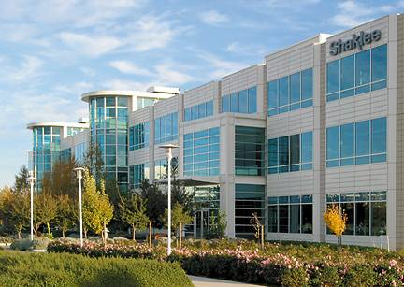
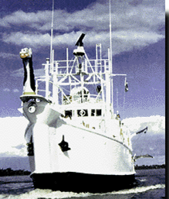
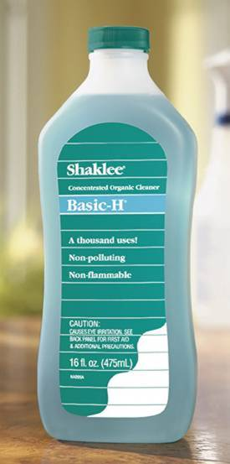
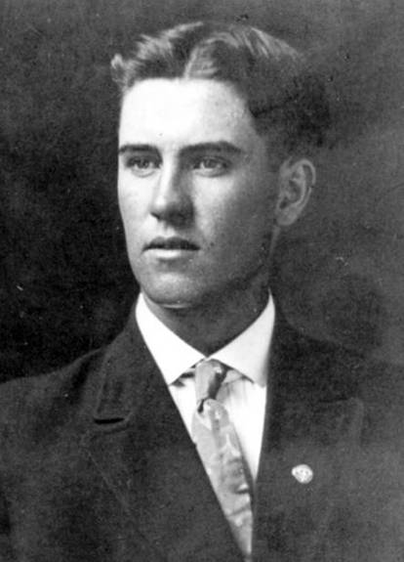
For 50 years, Shaklee has created products that improve the health of people and the planet
In 1960, Shaklee introduced Basic-H®, one of the first biodegradable, nontoxic cleaners
Basic-H was selected as an official Earth Day product, has been used on Jacques Cousteau’s ships, in the Biosphere 2 Project, Appalachian Mountain Club and by many other environmental groups

Slide 7
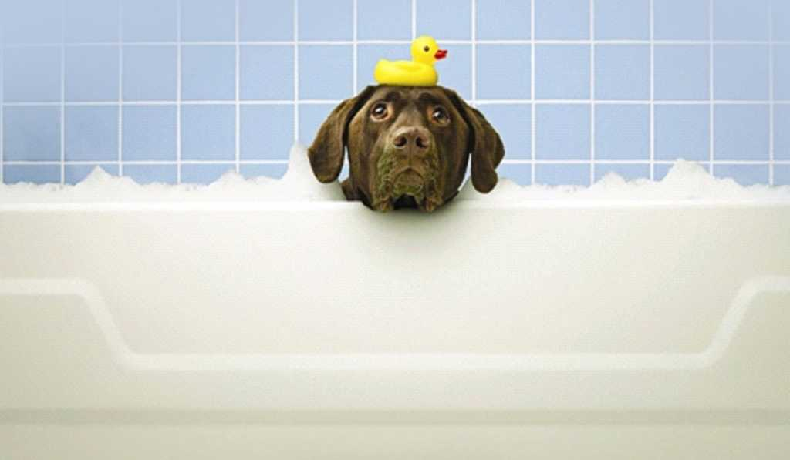
POWERFUL CLEAN
Dish Wash Liquid Concentrate is twice as effective as Method® Dish Soap and Seventh Generation® Dishwashing Liquid on grease*
Nature Bright® Laundry Booster and Stain Remover is twice as effective than OxiClean® on grass stains*
Basic H²™ Organic Super Cleaning Wipes cleans twice as much dirt than Pledge Wipes on vinyl flooring*
Fresh Laundry Concentrate HE Compatible is 33% Better at removing soil and stains than All® Small & Mighty™*
Basic H² (at ¼ tsp in 16 oz. water), Method® Go Naked Spray, and Seventh Generation® Free and Clear Spray were tested on clean tile. Both the Method and Seventh Generation products left film and streaks. Basic H² left none.
Fresh Laundry Concentrate HE Compatible Outperforms Shout® and Spray ‘n Wash® on spot removal*
*These performance comparisons were done on March 29, April 24, 2006 and January 11, 2007 and are valid only for the named products marketed at that time. All trademarks are the property of their respective owners.

Slide 8
GREEN CLEAN
We believe cleaning house shouldn’t involve dirtying the earth.
Earth-Friendly
Sustainable ingredients from natural sources
Biodegradable surfactants
Recyclable packaging
Recyclable wipes
Recyclable dryer sheets
No chlorine bleach
No phosphates
No nitrates
No borates
No volatile organic cleaning compounds
Shaklee does not and never has tested on animals

Slide 9
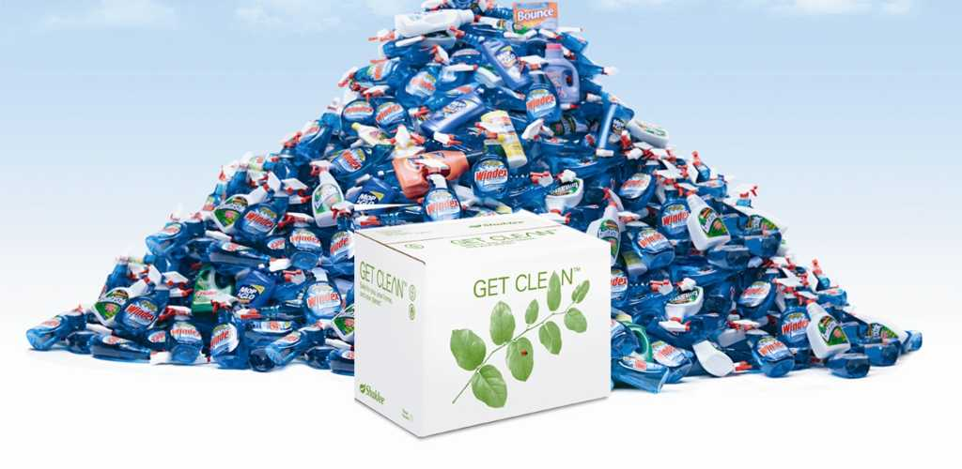
STARTER KIT
You would spend over $3,400 to get the same cleaning power from major name brands!*
60 Bottles of Fantastik®, 32 oz.
32 Bottles of Mop ‘n Glo®, 32 oz.
728 Bottles of Windex®, 26 oz.
1 Bottle of Woolite®, 50 oz.
1 Container of Clorox® Wipes
1 Bottle of Soft Scrub®
2.5 Boxes of Cascade®, 45 oz.
2 Boxes of Tide®, 50 oz.
3 Bottles of Downy®, 20 oz.
1 Box of Bounce®
41,000 pieces of plastic per square mile of ocean!
*Based on number of uses per label directions of ready-to-use cleaners. All trademarks are the property of their respective owners.

Slide 10
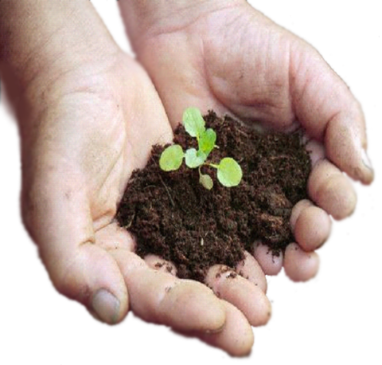
YOU CAN MAKE A DIFFERENCE!
Switching from conventional brands to the Get Clean™ Starter Kit:
Eliminates 108 pounds of packaging waste from landfills
Eliminates 248 pounds of greenhouse gases = 60,000 party balloons of CO₂
The environmental equivalent of planting 10 trees!

